Slide 1

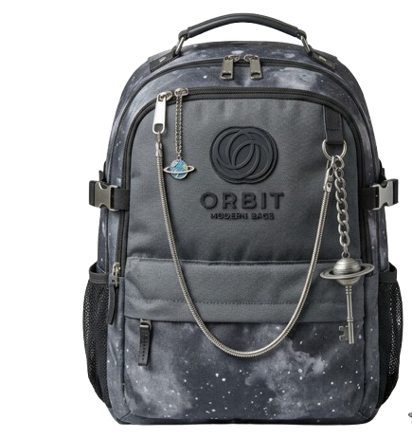

DIGITAL MARKETING ASSIGNMENT
Google Ads
Submitted By – Bhavesh Khemani
BCA 3rd Semester
Session – 2026–2027

Slide 2

Digital Marketing
Assignment Report
ASSIGNMENT FOLIO
Assignment Folio of Digital Marketing Submitted to
Dezyne École College Toward Digital Marketing By
BCA
3rd Semester
Bhavesh Khemani
Dezyne École College 106/10, Civil Lines, Ajmer www.dezyneecole.com 2026-2027

Slide 3
Digital Marketing
Assignment Report
ASSIGNMENT FOLIO
We take this opportunity to express our sincere gratitude to Dezyne École College for providing us with the knowledge, resources,
and guidance essential to the successful completion of this project.
Our deepest thanks to our respected Principal, Dr. Vinita Mathur, for her visionary leadership and continuous encouragement. Her commitment to academic excellence and student growth has been a constant source of motivation and pride.
We are equally thankful to all our faculty members for their consistent support, expert advice, and valuable insights that shaped our
learning and helped us achieve this milestone.
Lastly, we extend heartfelt thanks to everyone who directly or indirectly contributed to the success to this project.
We are proud to be part of Dezyne École College, an institution that truly nurtures professionalism, innovation, and purpose.
With Sincere appreciation,
Bhavesh Khemani
Department – BCA
Dezyne École College, Ajmer

Slide 4
Digital Marketing
Assignment Report
ASSIGNMENT FOLIO
Objective:
Increase Website Traffic, Generate Quality Leads, Improve Brand Visibility, Boost Course Enrollments & Maximize ROI
Key Features:
Search Campaign Strategy
Targeted high-intent keywords related to computer courses.
Structure Ad Groups
Separate ad groups for each course to improve relevant and Quality Score.
Optimized Wix Landing Page
Laptop-friendly design with strong call-to-action buttons.
Conversion Tracking Setup
Measure form submission and call clicks for performance analysis.
Smart Bidding Strategy
Used “Maximize Conversations” to optimize and spend automatically.

Slide 5
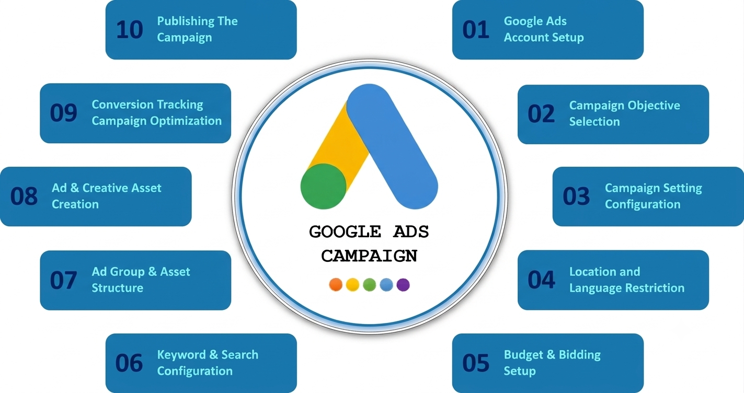

Slide 6

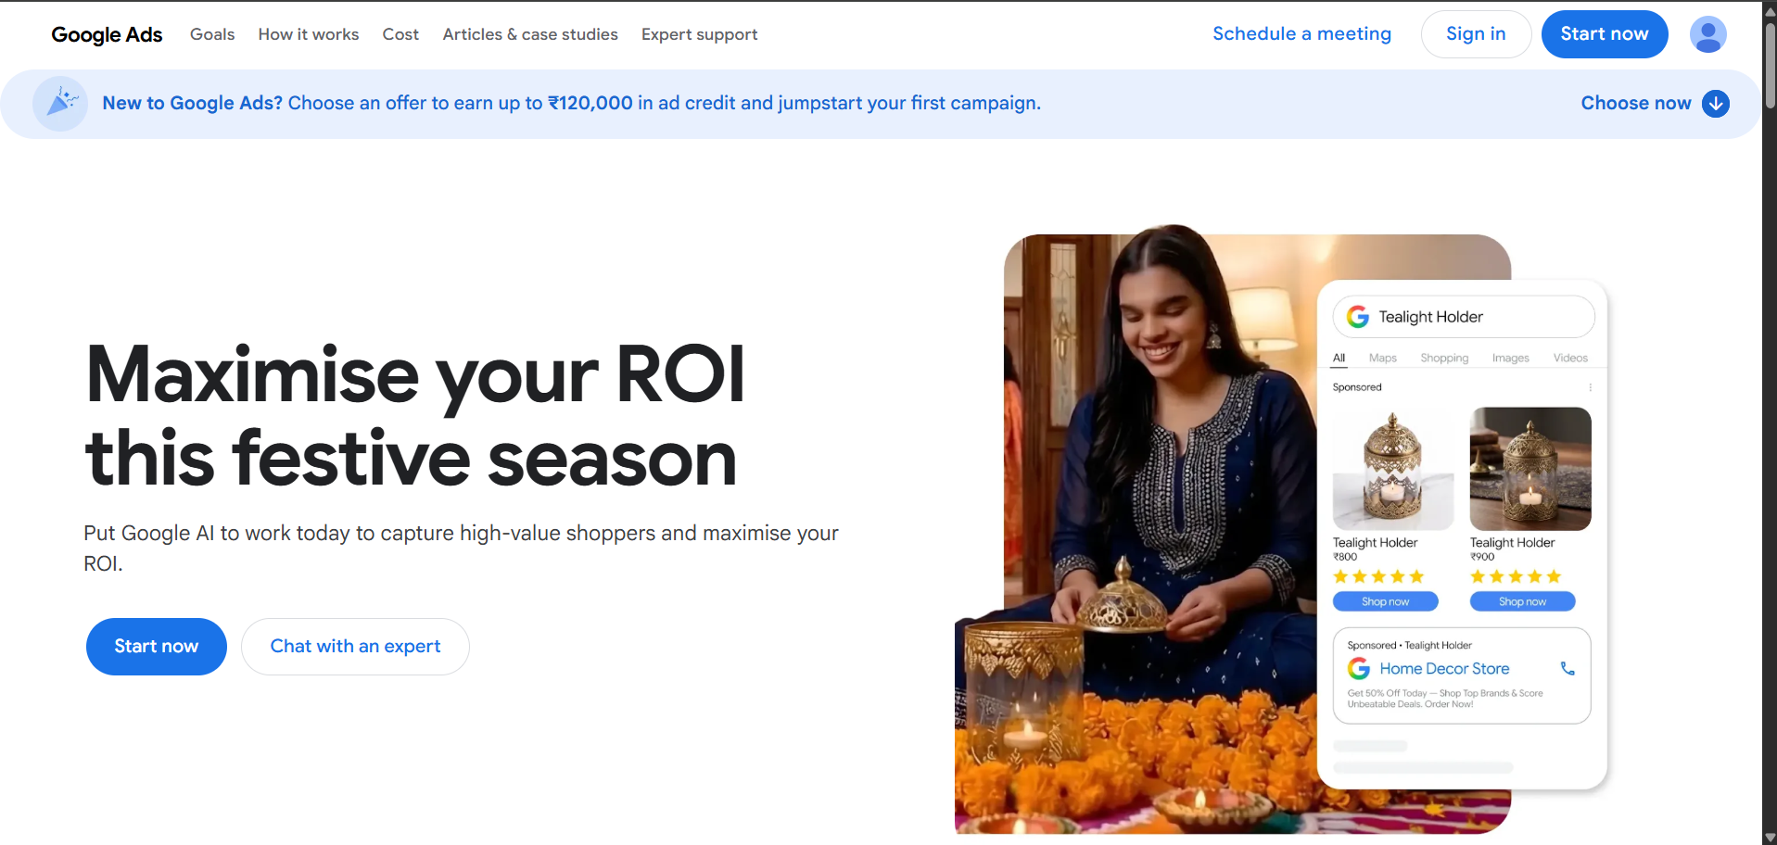
GOOGLE ADS ACCOUNT SETUP

Slide 7
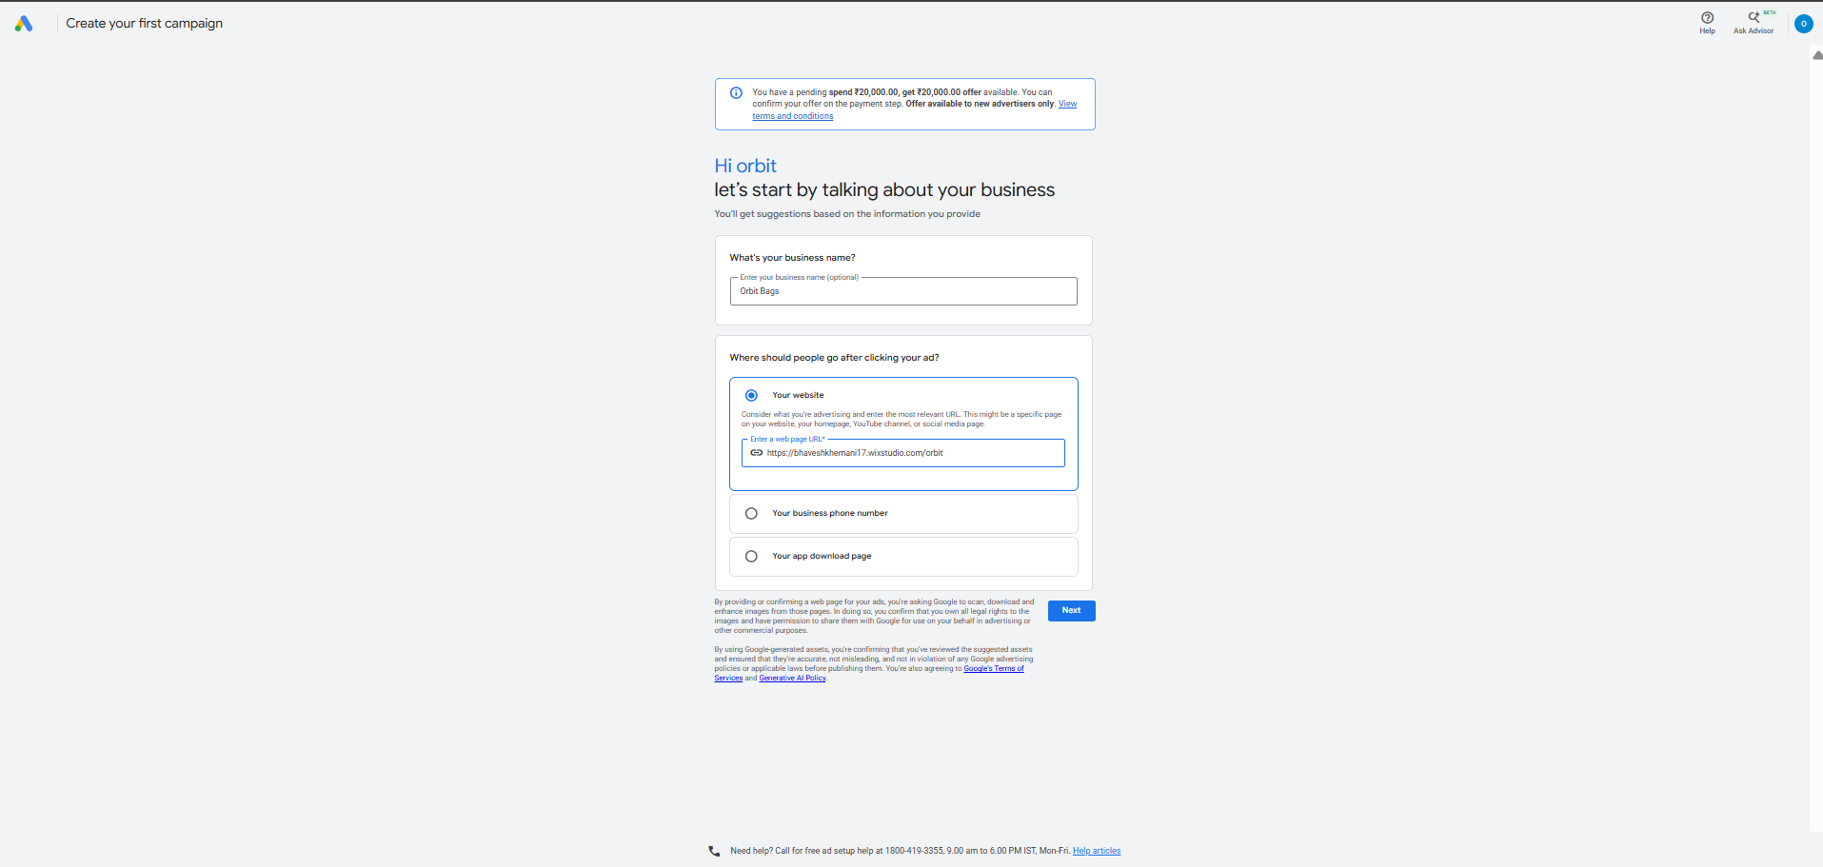
CAMPAIGN SETUP

Slide 8
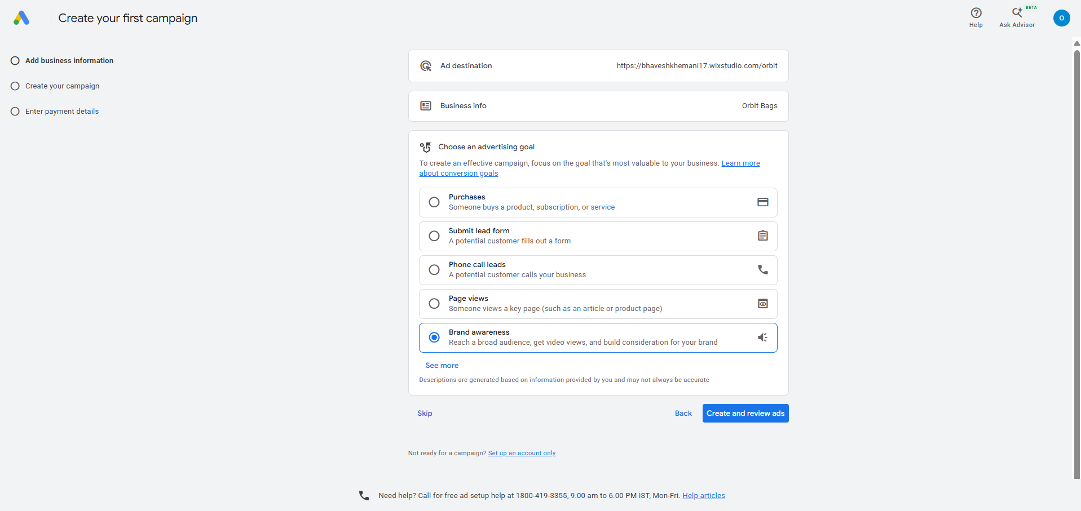
SETTING CAMPAIGN GOAL

Slide 9
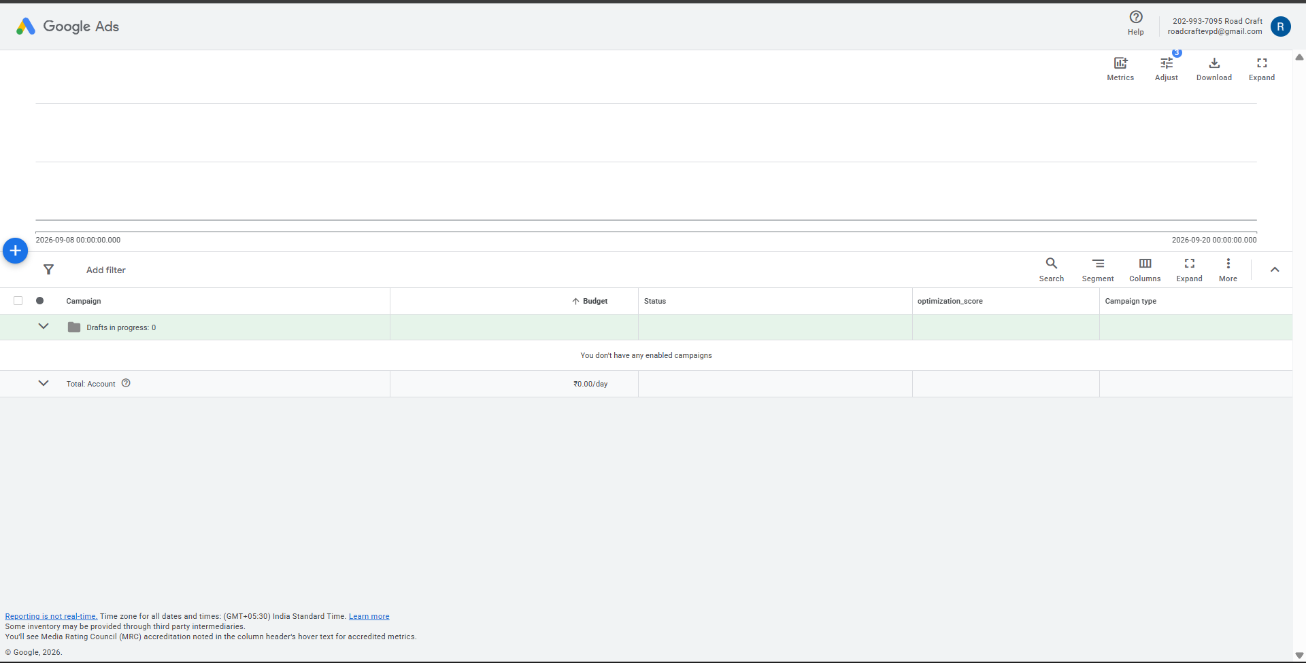
CAMPAIGN DASHBOARD

Slide 10
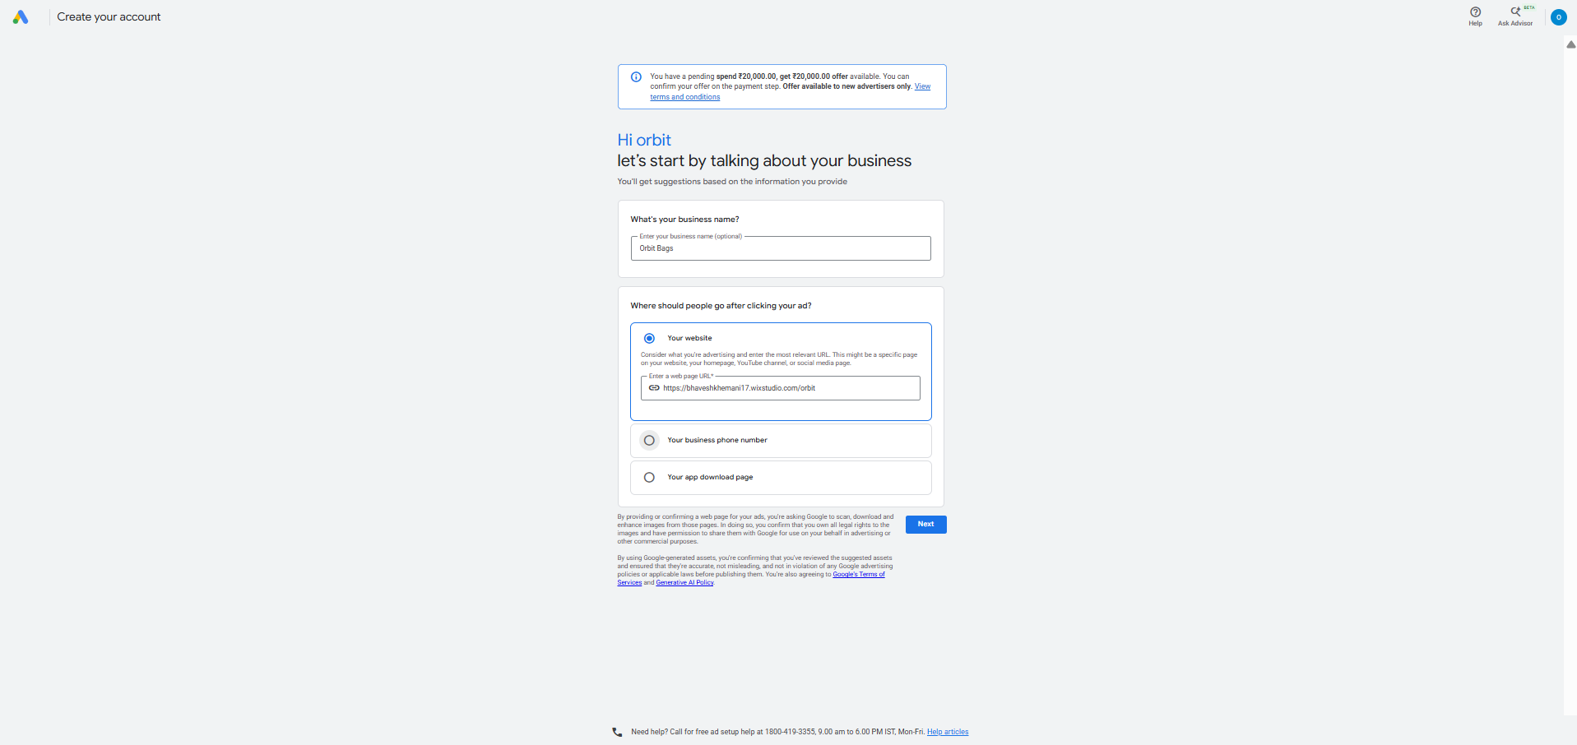
CHOOSING CAMPAIGN OBJECTIVE

Slide 11
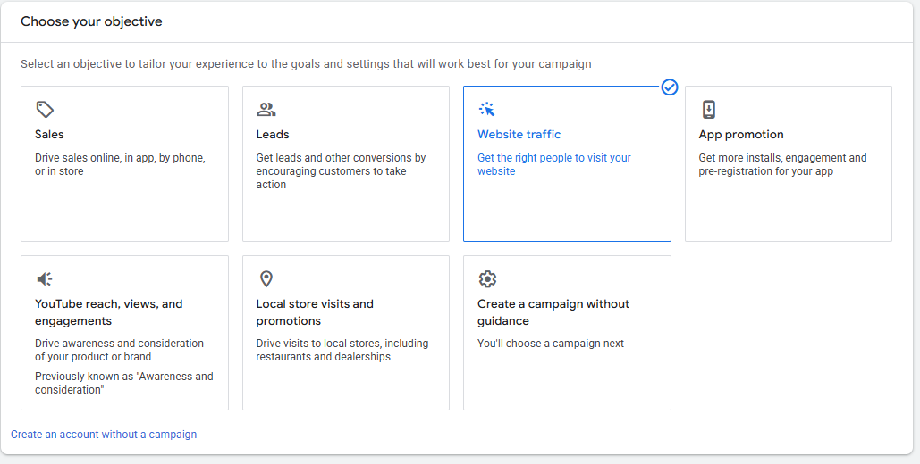
CHOOSING CAMPAIGN OBJECTIVE

Slide 12
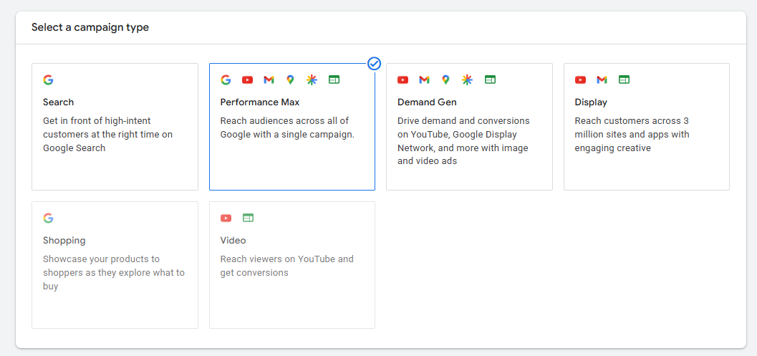
CHOOSING CAMPAIGN OBJECTIVE

Slide 13
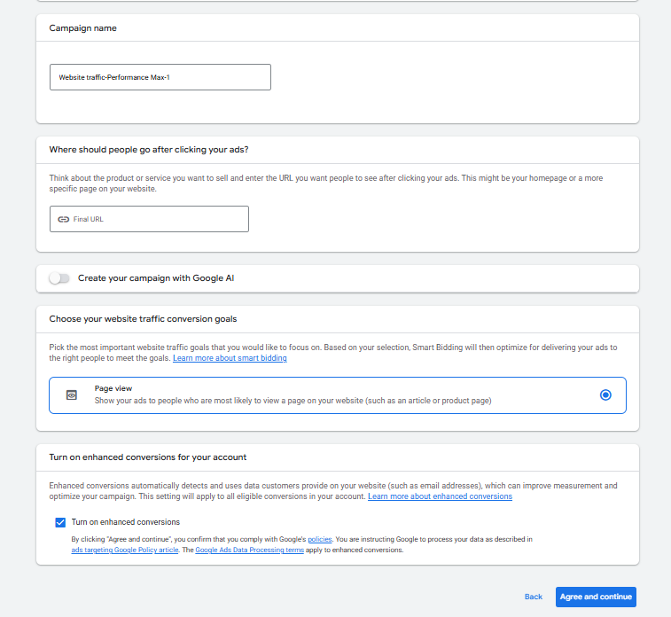
CHOOSING CAMPAIGN OBJECTIVE

Slide 14

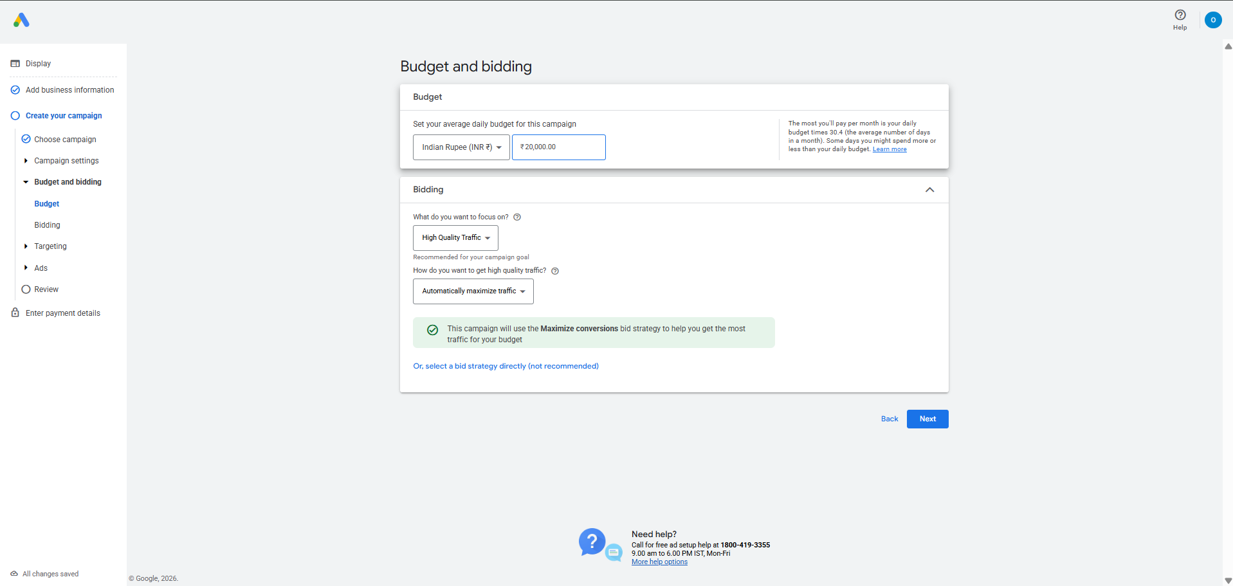
BIDDING

Slide 15

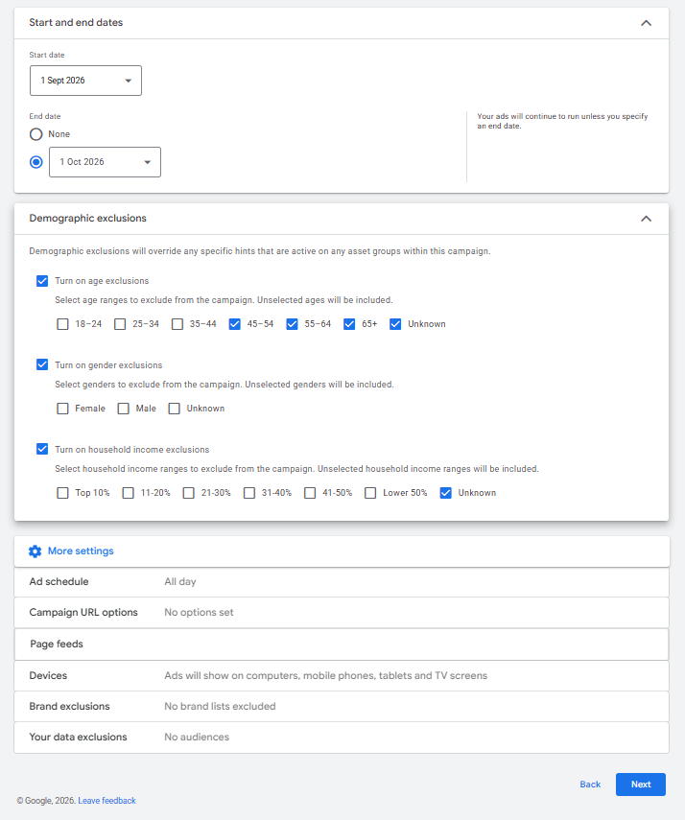
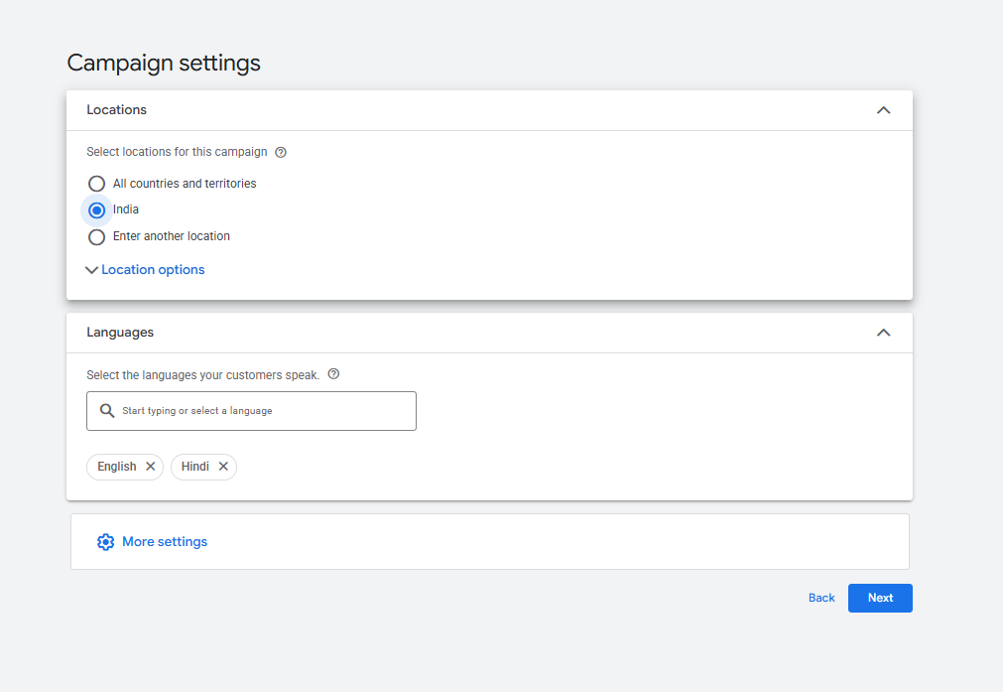
SETTING DEMOGRAPHICS

Slide 16
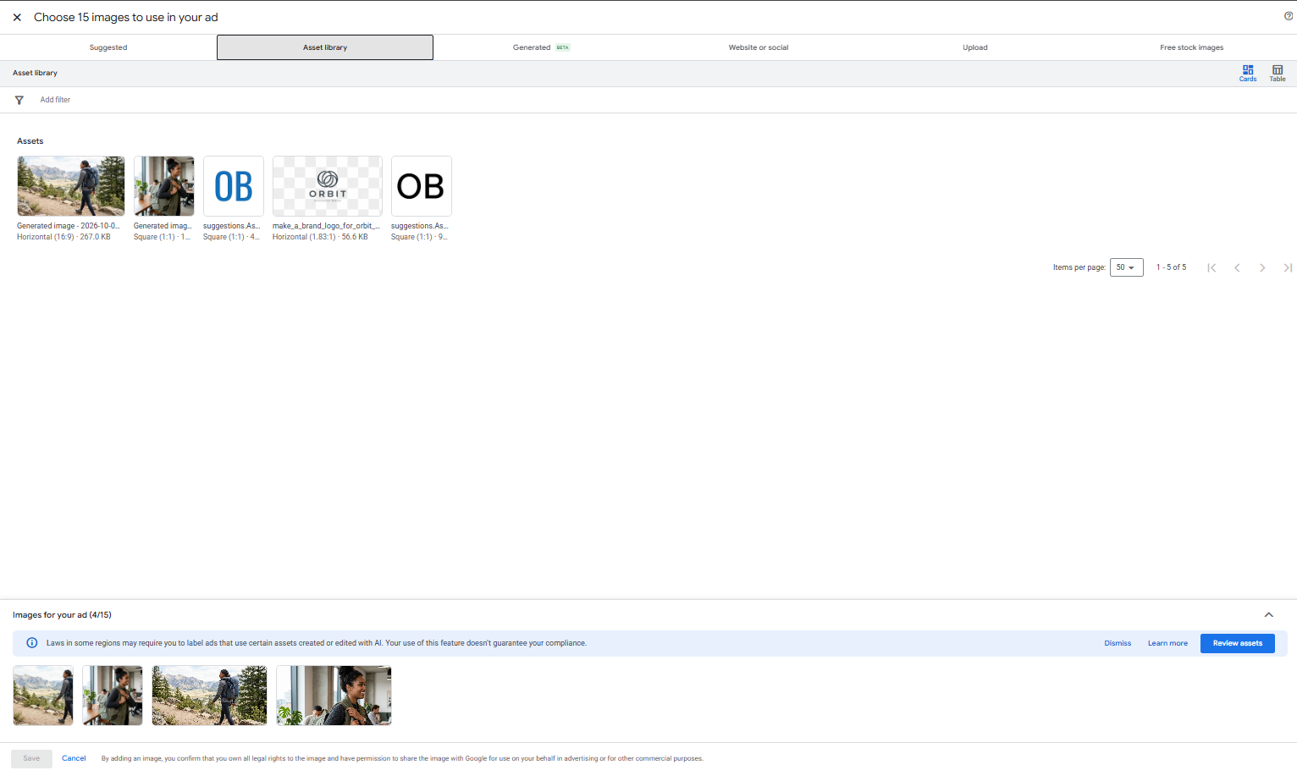
CREATIVE ASSETS CREATION

Slide 17
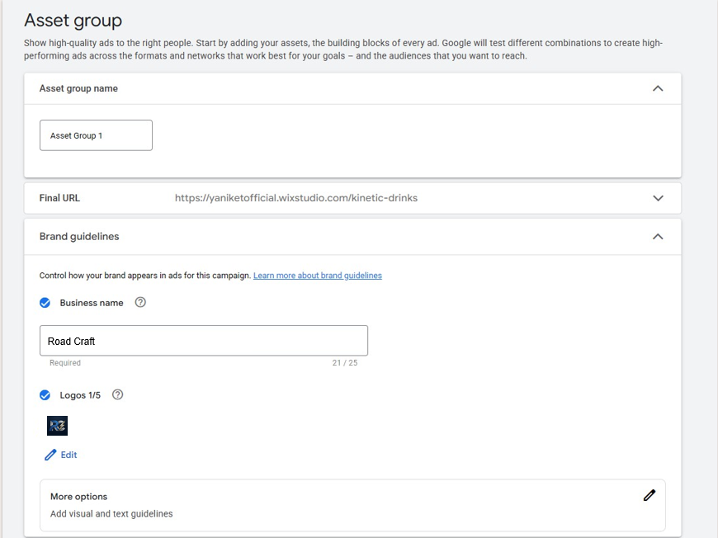
CREATIVE ASSETS CREATION

Slide 18
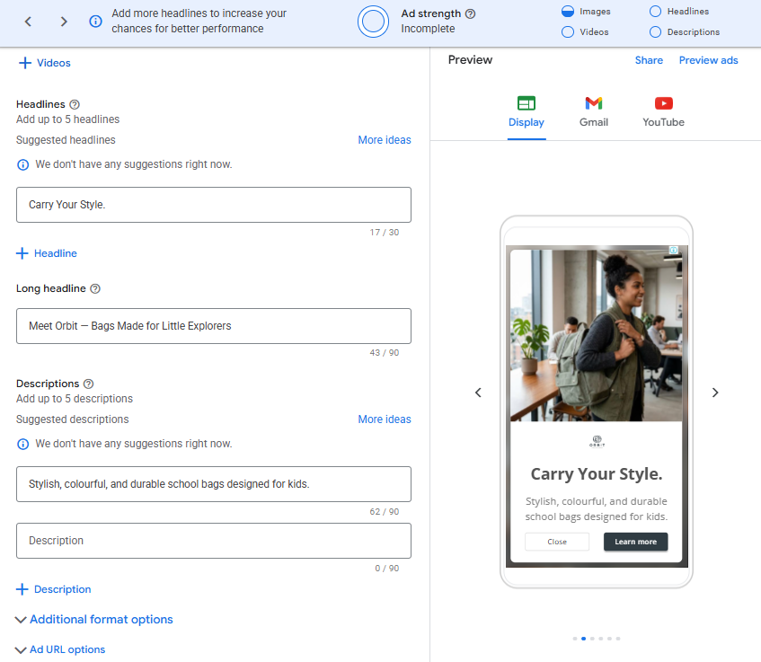
KEYWORD AND SEARCH CONFIGURATION

Slide 19
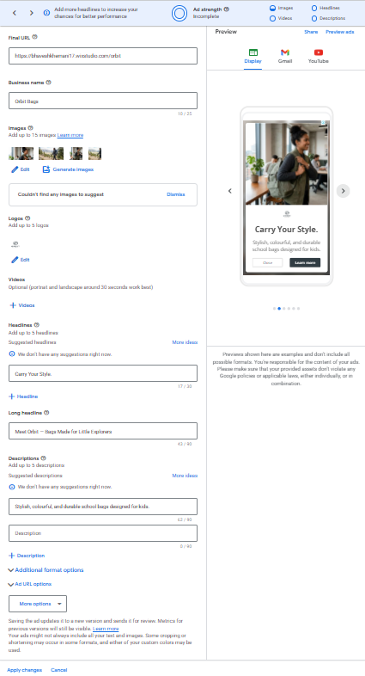
KEYWORD AND SEARCH CONFIGURATION

Slide 20
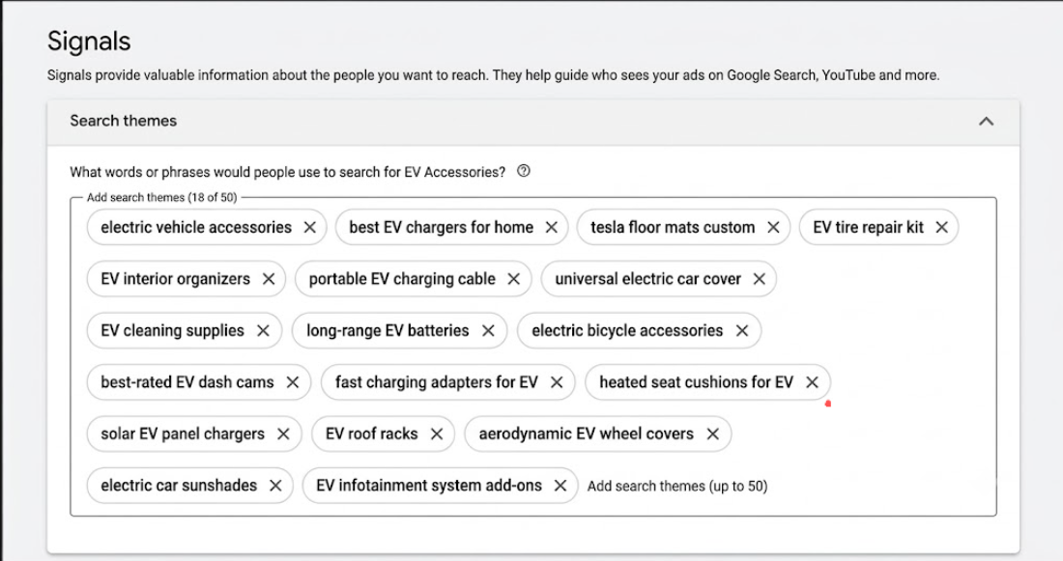
KEYWORD AND SEARCH CONFIGURATION

Slide 21
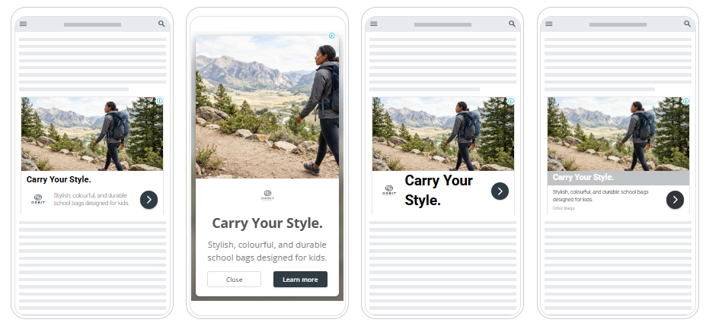
ADS PREVIEW

Slide 22
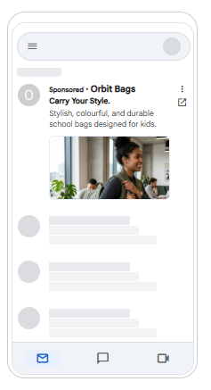
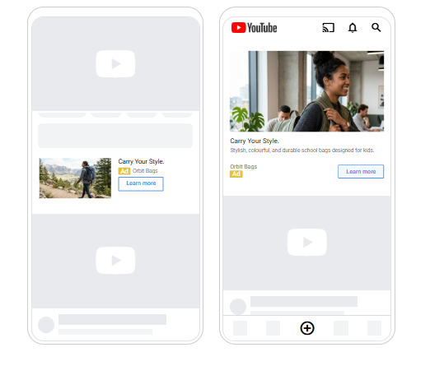
ADS PREVIEW

Slide 23

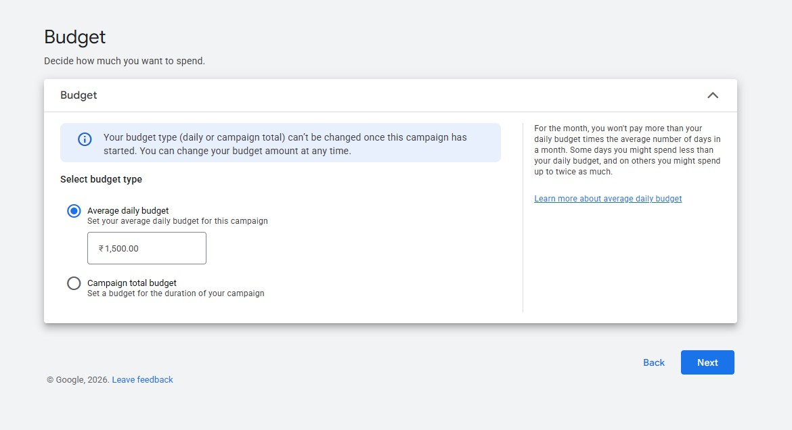
SETTING BUDGET

Slide 24

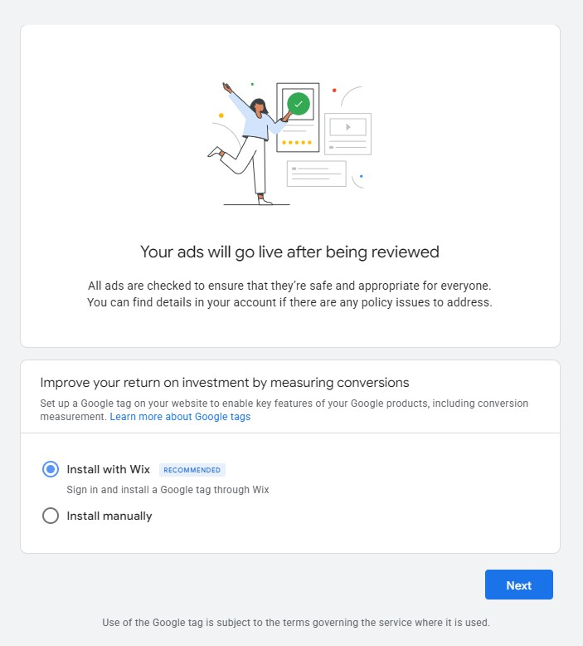
PUBLISHING THE CAMPAIGN

Slide 25

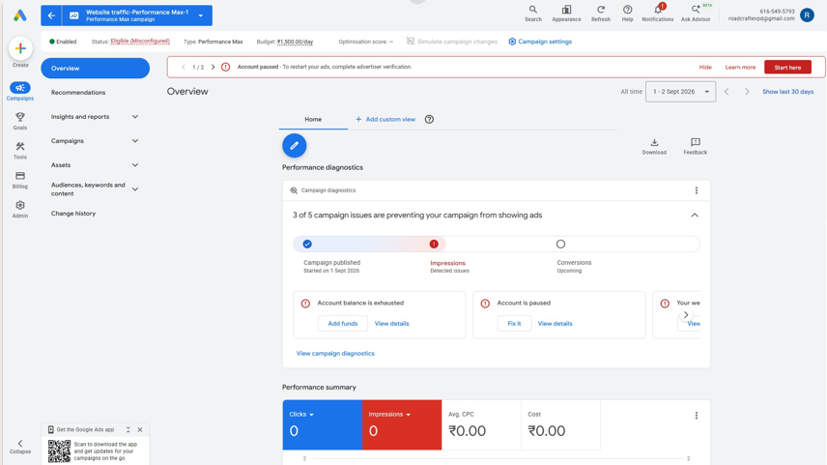
CAMPAIGN OVERVIEW

Slide 26


